Slide 1
Lecture 06 Processor Architecture COMP1411: Introduction to Computer Systems
Dr. Mingsong LYU (呂鳴松)
Department of Computing,
The Hong Kong Polytechnic University
Spring 2023
Acknowledgement: These slides are based on the textbook (Computer Systems: A Programmer’s Perspective) and its slides.
These slides are only intended to use internally. Do not publish it anywhere without permission.

Slide 2
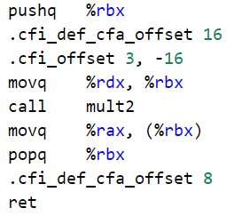
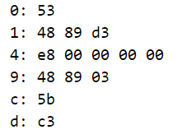
Outline
C Program
Programmers work
on these levels
(LEC04, LEC05)
Assembly (X86-64)
CPU
Design
(LEC06)
Machine Code
How machine instructions are designed
CPU Design
How execution instructions are executed on the HW components

Slide 3
Outline
Instruction Set Design
Instruction encoding
exemplified by a miniature X86 ISA
Sequential implementation of processor
CPU Pipelining

Slide 4
Outline
Instruction Set Design
Instruction encoding
exemplified by a miniature X86 ISA
Sequential implementation of processor
CPU Pipelining

Slide 5
Instruction Set Architecture Design
Designing processor states visible to programmers
Designing a set of instructions
Encoding the instructions
All the above designs will be exemplified by the Y86-64 ISA --- a much simpler X86 ISA enough to demonstrate the key concepts

Slide 6
Y86-64 processor state
15 64-bit general purpose registers
Conditional codes
ZF: zero; SF: negative; OF: overflow
Program Counter
Indicates address of next instruction
Memory
Byte-addressable storage array
Words stored in little-endian byte order
RF: Program registers
CC: Condition codes
Stat: Program status
%rax
%rsp
%r8
%r12
ZF
SF
OF
%rcx
%rbp
%r9
%r13
PC
DMEM: Memory
%rdx
%rsi
%r10
%r14
%rbx
%rdi
%r11

Slide 7
Y86-64 instruction set
Byte
0
1
2
3
4
5
6
7
8
9
halt
0
0
nop
1
0
cmovXX rA, rB
2
fn
rA
rB
irmovq V, rB
3
0
F
rB
V
rmmovq rA, D(rB)
4
0
rA
rB
D
mrmovq D(rB), rA
5
0
rA
rB
D
OPq rA, rB
6
fn
rA
rB
jXX Dest
7
fn
Dest
call Dest
8
0
Dest
ret
9
0
pushq rA
A
0
rA
F
popq rA
B
0
rA
F

Slide 8
Y86-64 instruction set
addq
6
0
jmp
7
0
rrmovq
2
0
subq
6
1
jle
7
1
cmovle
2
1
andq
6
2
jl
7
2
cmovl
2
2
xorq
6
3
je
7
3
cmove
2
3
jne
7
4
cmovne
2
4
jge
7
5
cmovge
2
5
jg
7
6
cmovg
2
6

Slide 9
Encoding registers
Each register is uniquely specified by a 4-bit ID
ID 15 (0xF) indicates “no register”
%rax
0
%r8
8
%rcx
1
%r9
9
%rdx
2
%r10
A
%rbx
3
%r11
B
%rsp
4
%r12
C
%rbp
5
%r13
D
%rsi
6
%r14
E
%rdi
7
No Register
F

Slide 10
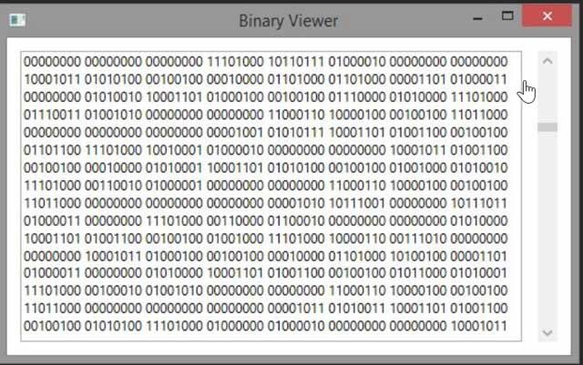
Instruction examples
Uniqueness (requirement on designing an ISA)
The encodings must have a unique interpretation
Given a sequence of bytes (machine code), it can be interpreted into only one valid sequence of instructions
From the first instruction, always being able to find the start byte of the next instruction
addq %rax, %rbx
6
0
0
3
rrmovq %rax, %r8
2
0
0
8
irmovq 0x36, %rbx
3
0
F
3
36 00 00 00 00 00 00 00
rmmovq %rcx, 0x41c(%rbx)
4
0
1
3
1C 04 00 00 00 00 00 00

Slide 11
Outline
Instruction Set Design
Instruction encoding
exemplified by a miniature X86 ISA
Sequential implementation of processor
CPU Pipelining

Slide 12
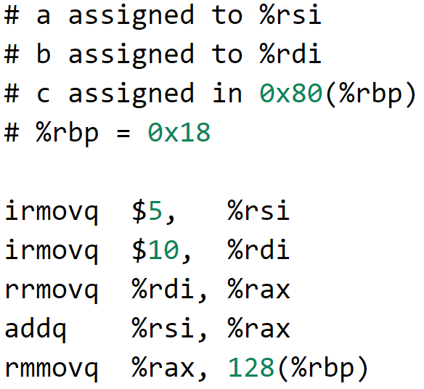
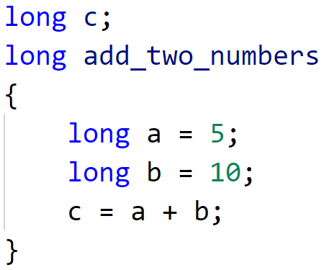
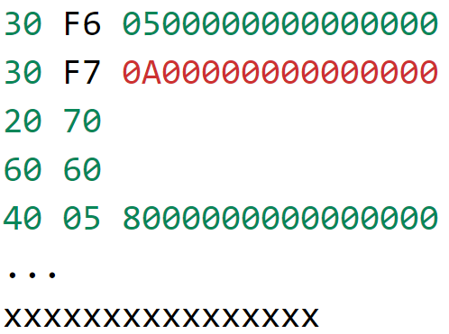
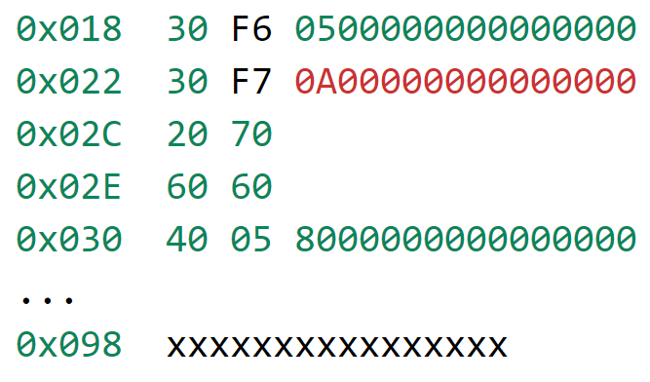
Up to now
Compilation
LEC04,05
LEC06
C program
Machine code
Assembly code
Execution
Register
file
ZF
SF
OF
How the machine instructions are executed on CPU?
PC
A
A
L
U
LEC06
Machine code
loaded into memory
B
OF
ZF
CF

Slide 13
Stages of instruction execution
PC update
newPC
Instructions are executed by multiple stages on the CPU
Different instructions follow the same stages
valE, valM
Write back
valM
Memory
Data
memory
Stages | Functions
Fetch | Read an instruction from the memory
Decode | Read operands from registers
Execute | Compute value/address
Memory access | Read or write data from/to memory
Write back | Write results to registers
PC update | Update PC, get ready for the next instruction
Addr, Data
valE
Execute
CC
ALU
Cnd
aluA, aluB
valA, valB
Decode
srcA, srcB
dstE, dstM
A
B
M
Register
file
E
icode, ifun
rA, rB
valC
valP
Fetch
Instruction
memory
PC
increment
PC

Slide 14
Computed values
Stored in CPU on hardware lines/pins
Fetch
icode Instruction code
ifun Instruction function
rA Instr. Register A
rB Instr. Register B
valC Instruction constant
valP Incremented PC
Decode
srcA Register ID A
srcB Register ID B
dstE Destination Register E
dstM Destination Register M
valA Register value A
valB Register value B
Execute
valE ALU result
Cnd Branch/move flag
Memory
valM Value from memory

Slide 15
Run the machine codes
Use an example program to show how the CPU runs a program in the machine code form
C program
Machine code
loaded into memory
Assembly code

Slide 16
Run the machine codes
PC update
newPC
valE, valM
Write back
valM
Memory
Data
memory
Addr, Data
Stages | irmovq V, rB | irmovq $5, %rsi
Fetch | icode: ifun ← M₁[PC] rA:rB ← M₁[PC+1] valC ← M₈[PC+2] valP ← PC+10 | icode: ifun ← M₁[0x018] = 3:0 rA:rB ← M₁[0x019] = F:6 valC ← M₈[0x01A] = 5 valP ← 0x018 + 10 = 0x022
Decode
Execute | valE ← 0 + valC | valE ← 0 + 5 = 5
Memory
Write back | R[rB] ← valE | R[%rsi] ← valE = 5
PC update | PC ← valP | PC ← valP = 0x022
valE
Execute
CC
ALU
Cnd
aluA, aluB
valA, valB
Decode
srcA, srcB
dstE, dstM
A
B
M
Register
file
E
icode, ifun
rA, rB
valC
valP
Fetch
Instruction
memory
PC
increment
PC

Slide 17
Run the machine codes
PC update
newPC
valE, valM
Write back
valM
Memory
Data
memory
Addr, Data
Stages | irmovq V, rB | irmovq $10, %rdi
Fetch | icode: ifun ← M₁[PC] rA:rB ← M₁[PC+1] valC ← M₈[PC+2] valP ← PC+10 | icode: ifun ← M₁[0x022] = 3:0 rA:rB ← M₁[0x023] = F:7 valC ← M₈[0x024] = 10 valP ← 0x022 + 10 = 0x02C
Decode
Execute | valE ← 0 + valC | valE ← 0 + 10 = 10
Memory
Write back | R[rB] ← valE | R[%rdi] ← valE = 10
PC update | PC ← valP | PC ← valP = 0x02C
valE
Execute
CC
ALU
Cnd
aluA, aluB
valA, valB
Decode
srcA, srcB
dstE, dstM
A
B
M
Register
file
E
icode, ifun
rA, rB
valC
valP
Fetch
Instruction
memory
PC
increment
PC

Slide 18
Run the machine codes
PC update
newPC
valE, valM
Write back
valM
Memory
Data
memory
Addr, Data
Stages | rrmovq rA, rB | rrmovq $rdi, %rax
Fetch | icode: ifun ← M₁[PC] rA:rB ← M₁[PC+1] valP ← PC+2 | icode: ifun ← M₁[0x02C] = 2:0 rA:rB ← M₁[0x02D] = 7:0 valP ← 0x02C + 2 = 0x02E
Decode | valA ← R[rA] | valA ← R[%rdi] = 10
Execute | valE ← 0 + valA | valE ← 0 + 10 = 10
Memory
Write back | R[rB] ← valE | R[%rax] ← valE = 10
PC update | PC ← valP | PC ← valP = 0x02E
valE
Execute
CC
ALU
Cnd
aluA, aluB
valA, valB
Decode
srcA, srcB
dstE, dstM
A
B
M
Register
file
E
icode, ifun
rA, rB
valC
valP
Fetch
Instruction
memory
PC
increment
PC

Slide 19
Run the machine codes
PC update
newPC
valE, valM
Write back
valM
Memory
Data
memory
Addr, Data
Stages | addq rA, rB | addq $rsi, %rax
Fetch | icode: ifun ← M₁[PC] rA:rB ← M₁[PC+1] valP ← PC+2 | icode: ifun ← M₁[0x02E] = 6:0 rA:rB ← M₁[0x02F] = 6:0 valP ← 0x02E + 2 = 0x030
Decode | valA ← R[rA] valB ← R[rB] | valA ← R[%rsi] = 5 valB ← R[%rax] = 10
Execute | valE ← valA + valB Set CC | valE ← 5 + 10 = 15 SF ← 0, ZF ← 0, OF ← 0
Memory
Write back | R[rB] ← valE | R[%rax] ← valE = 15
PC update | PC ← valP | PC ← valP = 0x030
valE
Execute
CC
ALU
Cnd
aluA, aluB
valA, valB
Decode
srcA, srcB
dstE, dstM
A
B
M
Register
file
E
icode, ifun
rA, rB
valC
valP
Fetch
Instruction
memory
PC
increment
PC

Slide 20
Run the machine codes
PC update
newPC
valE, valM
Write back
valM
Memory
Data
memory
Addr, Data
Stages | rmmovq rA, D(rB) | rmmovq %rax, 128(%rbp)
Fetch | icode: ifun ← M₁[PC] rA:rB ← M₁[PC+1] valC ← M₈[PC+2] valP ← PC+10 | icode: ifun ← M₁[0x030] = 4:0 rA:rB ← M₁[0x031] = 0:5 valC ← 128 valP ← 0x030 + 10 = 0x03A
Decode | valA ← R[rA] valB ← R[rB] | valA ← R[%rax] = 15 valB ← R[%rbp] = 0x018
Execute | valE ← valB + valC | valE ← 0x018 + 128 = 0x098
Memory | M₈[valE] ← valA | M₈[0x098] ← valA = 15
Write back
PC update | PC ← valP | PC ← valP = 0x03A
valE
Execute
CC
ALU
Cnd
aluA, aluB
valA, valB
Decode
srcA, srcB
dstE, dstM
A
B
M
Register
file
E
icode, ifun
rA, rB
valC
valP
Fetch
Instruction
memory
PC
increment
PC

Slide 21
Outline
Instruction Set Design
Instruction encoding
exemplified by a miniature X86 ISA
Sequential implementation of processor
CPU Pipelining

Slide 22
Pipeline
The whole production process is composed of multiple stages
Worker on each stage do only ONE thing
Products line up on the pipeline, each goes through all stages

Slide 23
Rethinking the sequential machine
PC update
newPC
Every instruction must go through 6 stages sequentially
In the sequential implementation, when the instruction is in one stage, e.g., execute, all the hardware components in other stages are idle
This is under-utilization of the processor hardware
valE, valM
Write back
valM
Memory
Data
memory
Addr, Data
valE
Execute
CC
ALU
Cnd
aluA, aluB
valA, valB
Decode
srcA, srcB
dstE, dstM
A
B
M
Register
file
E
icode, ifun
rA, rB
valC
valP
Fetch
Instruction
memory
PC
increment
PC

Slide 24
Understanding the performance of pipeline
Executing an instruction consumes 300ps (1ps = 10⁻¹²s)
How many instructions can we execute in 1s? (throughput, IPS)
1/(300 * 10⁻¹²) = 3.33 X 10⁹ instructions
Decompose the execution of each instruction into 3 stages, each stage takes 100ps to execute
How many instructions can we execute in 1s? (throughput, IPS)
1/(100 * 10⁻¹²) = 10¹⁰
3 times faster than the sequential execution
Instruction 1
300ps
Instruction 2
300ps
Instruction 3
300ps
I1
I1-S1
100ps
I1-S2
100ps
I1-S3
100ps
I2
I1-S1
100ps
I1-S2
100ps
I1-S3
100ps
I3
I1-S1
100ps
I1-S2
100ps
I1-S3
100ps
time

Slide 25
Overhead of pipeline
Adding registers between two consecutive pipeline stages
Each time a clock signal arrives, the result of stage-x will be written to the register between stage-x and stage-(x+1)
Once the result of stage-x is written, the next stage can start execution with the result as its input
Accessing registers introduces extra time delay; the end-to-end latency of finishing a single instruction is increased
Stage A
R
E
G
Stage B
R
E
G
Stage C
R
E
G
clock
latency

Slide 26
Redesign the CPU with pipeline
Write
back
Stat
Stat
W_stat
W
stat
icode
valE
valM
dstE
dstM
m_stat
dmem_error
data out
Stat
Mem.
control
read
Data
memory
Memory
write
data in
M_stat
Addr
M_Cnd
M_valA
M
stat
icode
Cnd
valE
valA
dstE
dstM
e_Cnd
CC
ALU
ALU
fun.
dstE
Execute
ALU
A
ALU
B
E_stat
E
stat
icode
ifun
valC
valA
valB
dstE
dstM
srcA
srcB
d_srcA
Select
A
d_rvalA
dstE
dstM
srcA
d_srcB
srcB
Decode
A
B
W_valM
Register
file
M
W_valE
D_stat
E
D
stat
icode
ifun
rA
rB
valC
valP
f_stat
Stat
Predict
PC
imem_error
instr_valid
Instruction
memory
PC
increment
Fetch
f_pc
Select
PC
M_valA
W_valM
F
predPC

Slide 27
Bad pipeline design
Nonuniform partitioning
Latency is determined by the longest stage
50ps
150ps
100ps
Stage A
R
E
G
Stage B
R
E
G
Stage C
R
E
G
clock
latency
I1
A
B
C
I2
A
B
C
I3
A
B
C
time

Slide 28
Make the pipeline stages uniform
50ps
50ps
50ps
50ps
50ps
50ps
Stage
A
R
E
G
Stage
B1
R
E
G
Stage
B2
R
E
G
Stage
B3
R
E
G
Stage
C1
R
E
G
Stage
C2
R
E
G
clock
I1
A
B1
B2
B3
C1
C2
I2
A
B1
B2
B3
C1
C2
I3
A
B1
B2
B3
C1
C2
time
More stages: deep pipeline
More stage registers → more time overhead
Sometimes, a stage cannot be decomposed

Slide 29
Data hazard in pipelines
Data dependencies: the results computed by one instruction are used as the data for a following instruction
Data hazard: data dependencies have the potential to cause computation errors by the pipeline

Slide 30
Data hazard in pipelines
1
2
3
4
5
6
7
8
0x000:
irmovq
$10,%
rdx
F
D
E
M
W
0x00a:
irmovq
$3,%
rax
F
D
E
M
W
0x014:
addq
%
rdx
,%
rax
F
D
E
M
W
0x016: halt
F
D
E
M
W
Cycle 4
M
F: fetch
D: decode
E: execute
M: memory
W: write back
M_
valE
= 10
M_
dstE
=
%
rdx
Values in %rdx and %rax have not been updated yet, as register update is done in the W stage → incorrect results
E
e_
valE
f
0 + 3 = 3
E_
dstE
=
%
rax
D
D
f
valA
f
valA
R[
R[
]
]
=
=
0
%
0
%
rdx
rdx
f
valB
f
valB
R[
R[
]
]
=
=
0
%
0
%
rax
rax

Slide 31
Solution: stalling with nop instructions
1
2
3
4
5
6
7
8
9
10
11
0x000: irmovq $10,%rdx
F
D
E
M
W
0x00a: irmovq $3,%rax
F
D
E
M
W
nop
F
D
E
M
W
nop
F
D
E
M
W
nop
F
D
E
M
W
0x017: addq %rdx,%rax
F
D
E
M
W
0x018: halt
F
D
E
M
W

Slide 32
Pipeline design
Stalling a pipeline reduces performance
There are other ways to remove the data hazards
There are control hazards, and of course solutions
There are out-of-order pipelines (instruction execution sequence are changed), multi-issue pipelines
……
Pipelines are a key feature to the performance of contemporary powerful CPUs, very complex designs exist

Slide 33
Summary
Instruction Set Design
Instruction encoding
exemplified by a miniature X86 ISA
Sequential implementation of processor
CPU Pipelining

Slide 34
Thank You

